Slide 1
RESTful Services

Slide 2

REST Concept
Actually only the difference is how clients access our service. Normally, a service will use SOAP, but if you build a REST service, clients will be accessing your service with a different architectural style (calls, serialization like JSON, etc.).
REST uses some common HTTP methods to insert/delete/update/retrieve information which is below:
GET - Requests a specific representation of a resource
PUT - Creates or updates a resource with the supplied representation
DELETE - Deletes the specified resource
POST - Submits data to be processed by the identified resourc

Slide 3

What is REST?
REpresentational State Transfer
▫ PhD by Roy Fielding
▫ The Web is the most successful application on the Internet
▫ What makes the Web so successful?
Addressable Resources
▫ Every “thing” should have an ID
▫ Every “thing” should have a URI
Constrained interface
▫ Use the standard methods of the protocol
▫ HTTP: GET, POST, PUT, DELETE
Resources with multiple representations
▫ Different applications need different formats
▫ Different platforms need different representations (XML + JSON)
Communicate statelessly
▫ Stateless application scale

Slide 4

Every “thing” has a URI
Addressability
http://sales.com/customers/323421
http://sales.com/customers/32341/address
From a URI we know
▫ The protocol (How do we communicate)
▫ The host/port (Where it is on network)
▫ The resource path(What resource are we communicating with

Slide 5

Describing a URI
http://sales.com/customers/323421
/customers/{customer-id}
Human readable URIs: Desired but not required
URI Parameters
http://sales.com/customers?zip=49009
Query parameters to find other resources
http://sales.com/cars/mercedes/amg/e55;color=black
Matrix parameters to define resource attributes

Slide 6

Implications of a Uniform Interface
Intuitive
▫ You know what operations the resource will support
Predictable behavior
▫ GET - readonly and idempotent. Never changes the state of the resource
▫ PUT - an idempotent insert or update of a resource.
Idempotent because it is repeatable without side effects.
▫ DELETE - resource removal and idempotent.
▫ POST - non-idempotent, “anything goes” operation
Clients, developers, admins, operations know what to expect
▫ Much easier for admins to assign security roles
▫ For idempotent messages, clients don’t have to worry about duplicate messages.

Slide 7

REST
"Representational State Transfer is intended to evoke an image of how a well-designed Web application behaves: a network of web pages (a virtual state- machine), where the user progresses through an application by selecting links (state transitions), resulting in the next page (representing the next state of the application) being transferred to the user and rendered for their use.“

Slide 8

Why REST?
Less overhead (no SOAP envelope to wrap every call in)
Less duplication (HTTP already represents operations
like DELETE, PUT, GET, etc. that have to otherwise be represented in a SOAP envelope).
More standardized - HTTP operations are well understood and operate consistently. Some SOAP implementations can get finicky.
More human readable and testable (harder to test SOAP with just a browser).
Don't need to use XML (well, you kind of don't have to for SOAP either but it hardly makes sense since you're already doing parsing of the envelope).
Libraries have made SOAP (kind of) easy. But you are abstracting away a lot of redundancy underneath as I have noted. Yes, in theory, SOAP can go over other transports so as to avoid riding atop a layer doing similar things, but in reality just about all SOAP work you'll ever do is over HTTP.

Slide 9

REST Data Elements
Resources and Resource Identifiers
Uniform Interface (GET, PUT, POST, DELETE)
Resource Oriented
Simple and simple is beautiful
HTTP | Method | CRUD | Desc.
POST | CREATE | Create | -
GET | RETRIEVE | Retrieve | Safe,Idempotent,Cacheable
PUT | UPDATE | Update | Idempotent
DELETE | DELETE | Delete | Idempotent

Slide 10

REST Core Ideologies
Simple is better
The web works and works well
Some web services should follow the “way of the web”.

Slide 11

RESTful Services
Resources as URI
▫ Use unique URI to reference every resource on your API
Operations as HTTP Methods
▫ GET – Queries
▫ POST – Queries
▫ PUT, DELETE – Inset, Update and delete
Connectedness and Discoverability
▫ Like the Web, HTTP Responses contains links to other resources

Slide 12

REST API EXAMPLE: Delicious
URL | http://del.icio.us/api/[username]/book marks/
Method | GET
Querystring | tag= | Filter by tag
 | dt= | Filter by date
 | start= | The number of the first bookmark to return
 | end= | The number of the last bookmark to return
Returns | 200 OK & XML (delicious/bookmarks+xml)
 | 401 Unauthorized
 | 404 Not Found

Slide 13

REST API EXAMPLE: Delicious
URL | http://del.icio.us/api/[usern ame]/bookmarks/
Method | POST
Request Body | XML (delicious/bookmark+xml)
Returns | 201 Created & Location
 | 401 Unauthorized
 | 415 Unsupported Media Type

Slide 14

REST API EXAMPLE: Delicious
URL | http://del.icio.us/api/[usern ame]/bookmarks/[hash]
Method | DELETE
Returns | 204 No Content
 | 401 Unauthorized
 | 404 Not Found

Slide 15

Designing services with a Uniform Interface
When in doubt, define a new resource
/orders
▫ GET - list all orders
▫ POST - submit a new order
/orders/{order-id}
▫ GET - get an order representation
▫ PUT - update an order
▫ DELETE - cancel an order
/orders/average-sale
▫ GET - calculate average sale
/customers
▫ GET - list all customers
▫ POST - create a new customer
/customers/{cust-id}
▫ GET - get a customer representation
▫ DELETE- remove a customer
/customers/{cust-id}/orders
▫ GET - get the orders of a customer

Slide 16

Resources with Multiple Representations
HTTP Headers manage this negotiation
▫ CONTENT-TYPE: specifies MIME type of message body
▫ ACCEPT: comma delimited list of one or more MIME types the client would like to receive as a response
▫ In the following example, the client is requesting a customer representation in either xml or json format
GET /customers/33323
ACCEPT: application/xml,application/json
Preferences are supported and defined by HTTP specification
GET /customers/33323 ACCEPT: text/html;q=1.0,
application/json;q=0.5;application/xml;q=0.7

Slide 17

What is JSON?
JavaScript Object Notation
Lightweight syntax for representing data
Easier to “parse” for JavaScript client code
Alternative to XML in AJAX applications
[{"Email":"bob@example.com","Name":"Bob"},{"Email
":"mark@example.com","Name":"Mark"},{"Email":"j ohn@example.com","Name":"John"}]

Slide 18
EXAMPLES:
Publish and Consume REST Services

Slide 19

EXAMPLES of REST APIs:
Facebook Graph API Google Custom Search API Yahoo
… and a lot more …

Slide 20

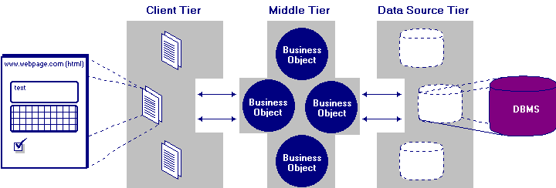
n-Tiers Architecture
SOAP and REST based web-services enable the 3-tier architecture to be extended into n-tiers.
•

Slide 21

JAX-RS
JCP Specification
▫ Lead by Sun, Marc Hadley
▫ Currently in public draft (which means final draft right around the corner)
Annotation Framework
Dispatch URI’s to specific classes and methods that can handle requests
Allows you to map HTTP requests to method invocations
IMO, a beautiful example of the power of parameter annotations
Nice URI manipulation functionality

Slide 22

JAX-RS Annotations
@Path
▫ Defines URI mappings and templates
@ProduceMime, @ConsumeMime
▫ What MIME types does the resource produce and consume
@GET, @POST, @DELETE, @PUT, @HEADER
▫ Identifies which HTTP method the Java method is interested in

Slide 23

JAX-RS Parameter Annotations
@PathParam
▫ Allows you to extract URI parameters/named URI template segments
@QueryParam
▫ Access to specific parameter URI query string
@HeaderParam
▫ Access to a specific HTTP Header
@CookieParam
▫ Access to a specific cookie value
@MatrixParam
▫ Access to a specific matrix parameter
Above annotations can automatically map HTTP request values to
▫ String and primitive types
▫ Class types that have a constructor that takes a String parameter
▫ Class types that have a static valueOf(String val) method
▫ List or Arrays of above types when there are multiple values
@Context
▫ Access to contextual information like the incoming URI

Slide 24

JAX-RS Resource Classes
JAX-RS annotations are used on POJO classes
The default component lifecycle is per-request
▫ Same idea as @Stateless EJBs
Root resources identified via @Path annotation on class

Slide 25

JAX-RS
@Path(“/orders”)
public class OrderService {
@Path(“/{order-id}”) @GET
@ProduceMime(“application/xml”)
String getOrder(@PathParam(“order-id”) int id) {
…
}
}

Slide 26

Default Response Codes
GET and PUT
▫ 200 (OK)
DELETE and POST
▫ 200 (OK) if content sent back with response
▫ 204 (NO CONTENT) if no content sent back

Slide 27

Response Object
JAX-RS has a Response and ResponseBuilder class
▫ Customize response code
▫ Specify specific response headers
▫ Specify redirect URLs
▫ Work with variants
@GET
Response getOrder() {
ResponseBuilder builder = Response.status(200); builder.type(“text/xml”)
.header(“custom-header”, “33333”); return builder.build();
}

Slide 28

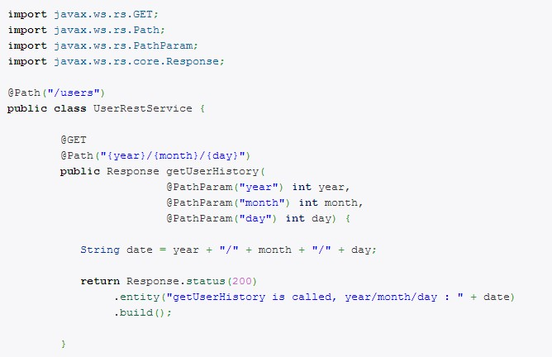
RESTful Service Example:

Slide 29

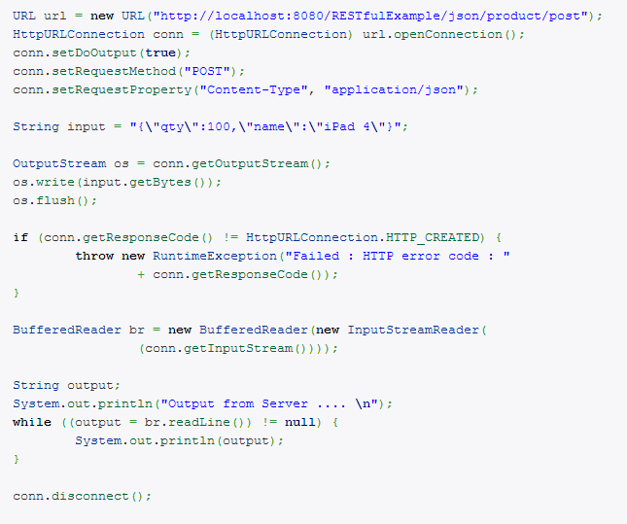
java.net.URL RESTful Client:

Slide 30

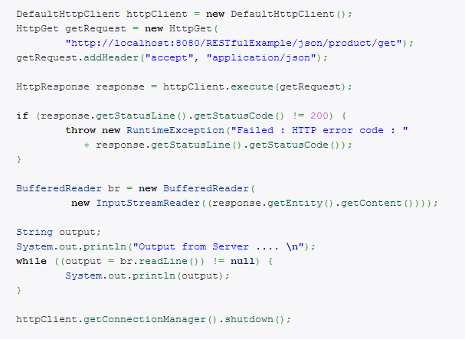
Apache HttpClient:

Slide 31

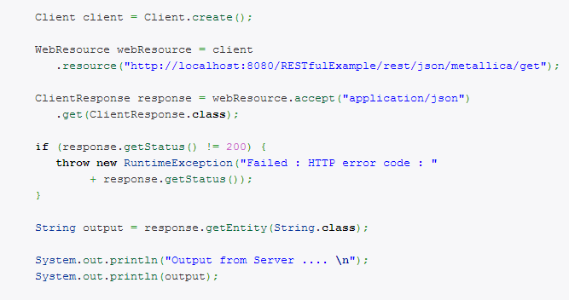
Jersey Client (jersey-client.jar):

Slide 32

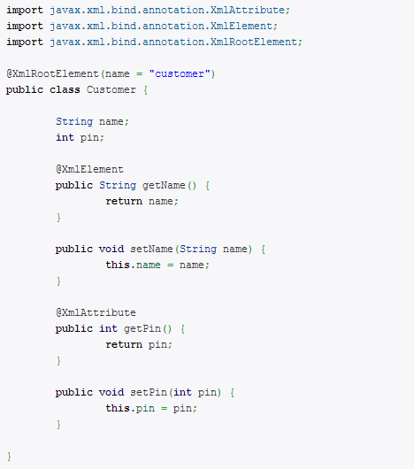

JAXB Annotations:
Produces:

Slide 33

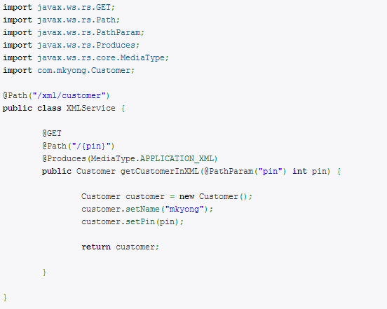
JAX-RS Service that Returns XML:

Slide 34
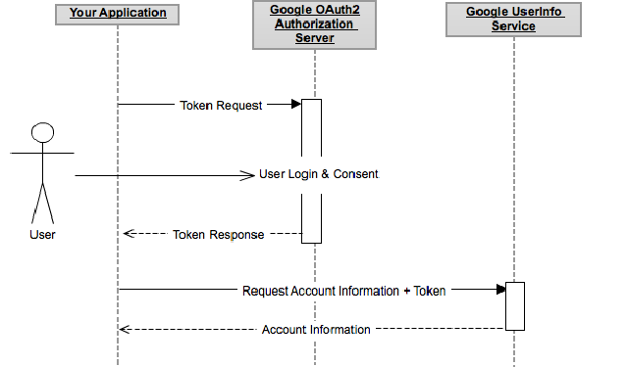
OAuth2.0
OAuth 2.0 is a relatively simple protocol and a developer can integrate with Google's OAuth
2.0 endpoints without too much effort. In a nutshell, you register your application with Google, redirect a browser to a URL, parse a token from the response, and send the token to the Google API you wish to access.

